Slide 1



HackNite- Zense
Discord Bot
The 3E Bot
Done By:
Chinmay Sultania(IMT2021540)
Anushka Singh(IMT2021531)

Slide 2
Inspiration
There are times when we feel lonely or low and at these times we need some sort of a companion with whom we can spend time.
This project is somewhat inspired from the Amazon Alexa and offers some of the basic functionalities that such AI powered cloud hosted assistants perform

Slide 3
What does 3E do
3E stands for Educate Entertain and Encourage
So whether you are in the mood to get entertained or in the mood for some daily news or are feeling low and stressed and want to relax 3E will do it for you.
Educate: Provides daily live news on various topics like Health, Business, Sports, Finance etc.
Entertain: Offers variety of entertainment means like jokes, riddles, songs, games
Encourage: Gives you an empowering quote followed by a quick 1 min meditation session.

Slide 4
How it was built
The bot was built on an online IDE repl.it so that it could be hosted on cloud
The language used for the bot is python due to its functionality and powerful modules
The main modules used for the project are: discord.py, requests, time, json, newsapi and keep_alive

Slide 5
Challenges faced
Had a very hard time understanding async and use of ‘@’ in python
It took a lot of time to understand the format in which each API had to be integrated into the code since some come without keys and some use headers function
Had to make sure I didn’t cross the requests limit for each API while testing the code
Took a lot of pain in finding the required API’s and had to create our own database for riddles since there were no free API’s for them

Slide 6
Screenshots

Slide 7
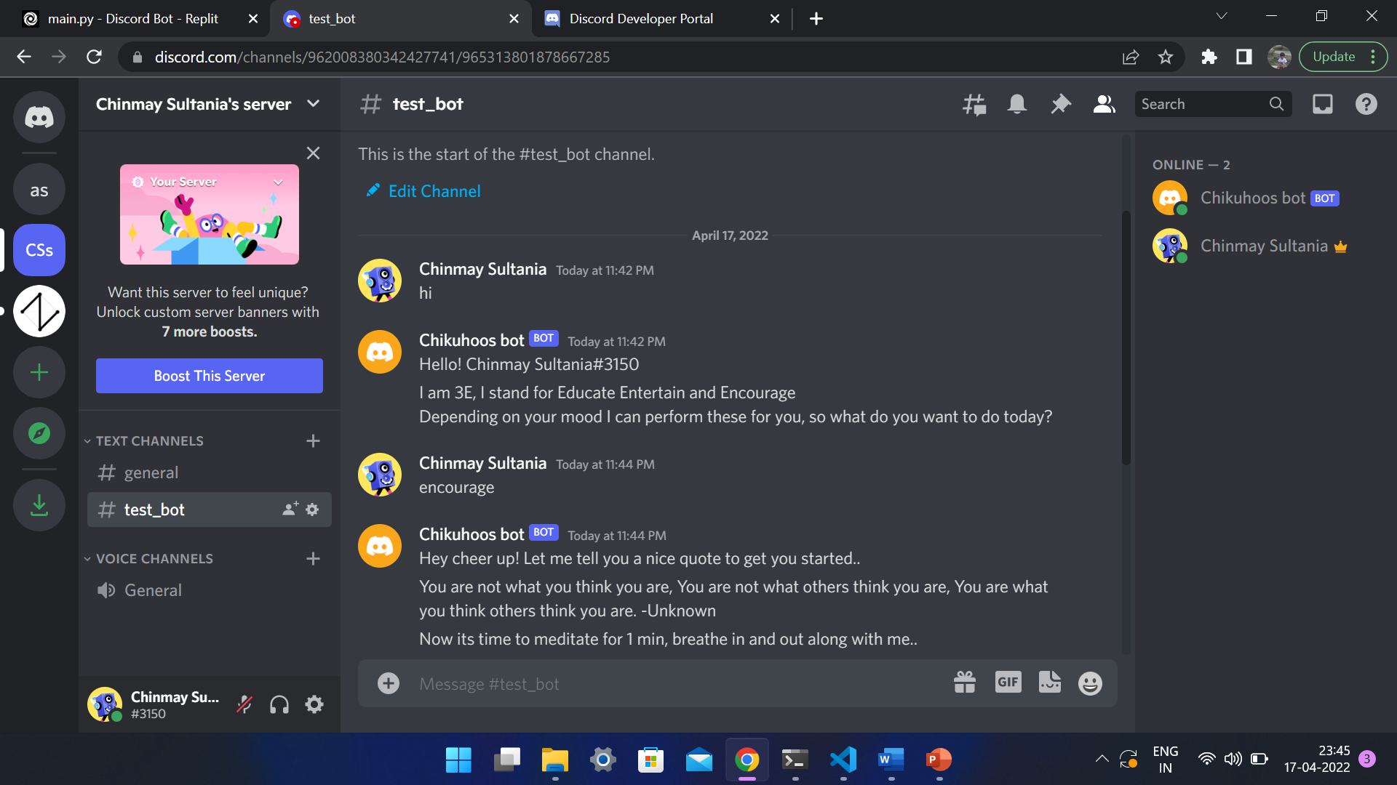
Screenshots

Slide 8
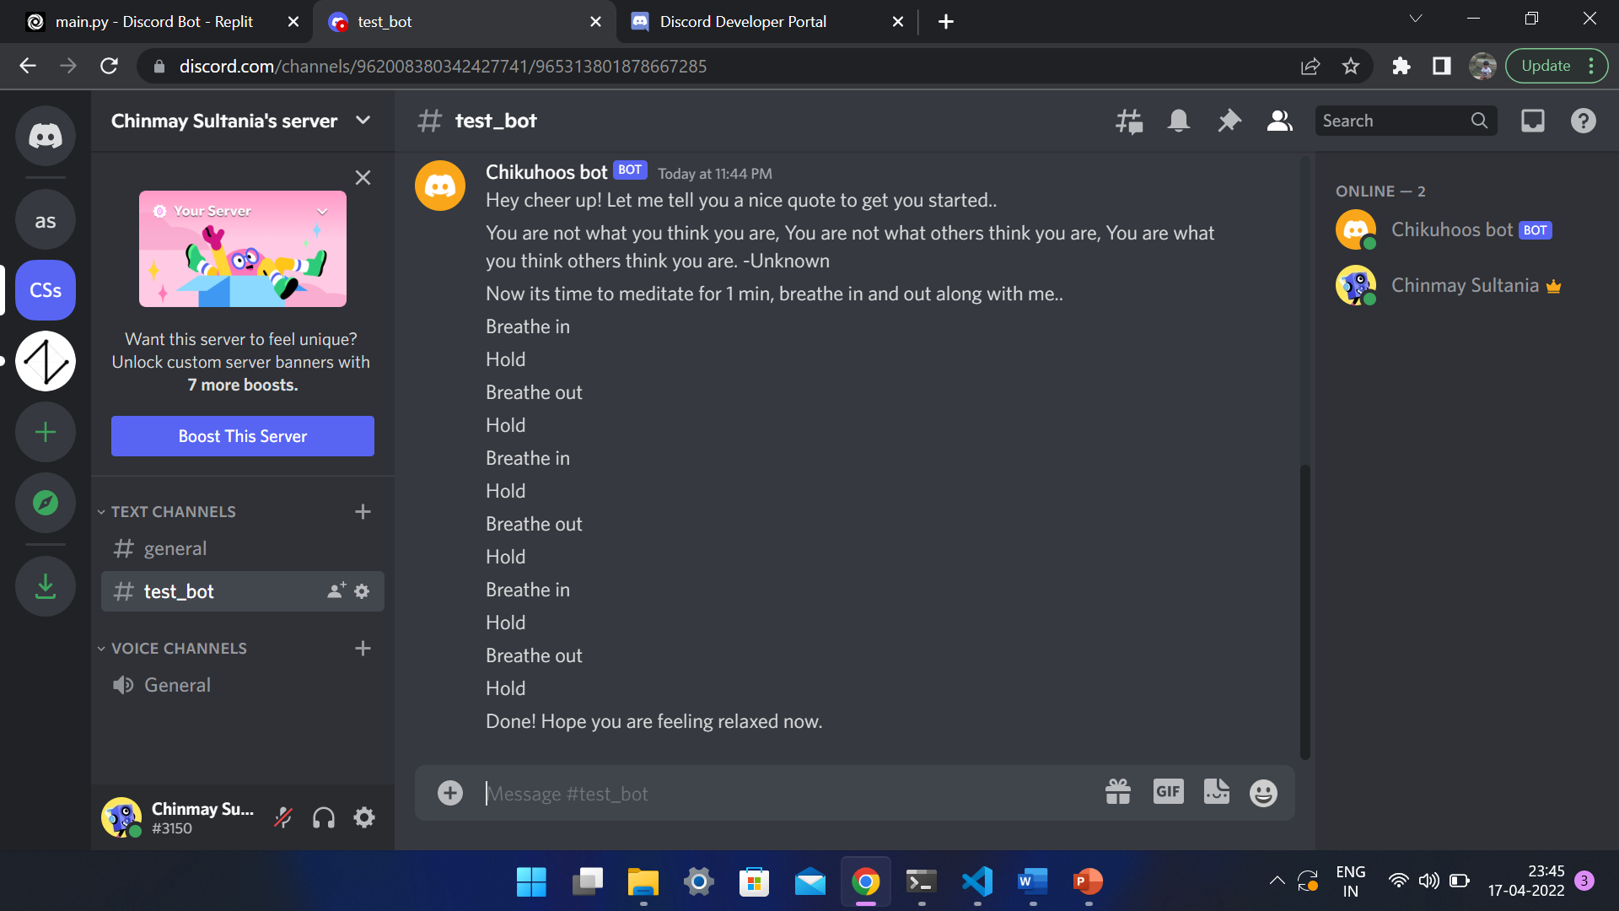

Slide 9
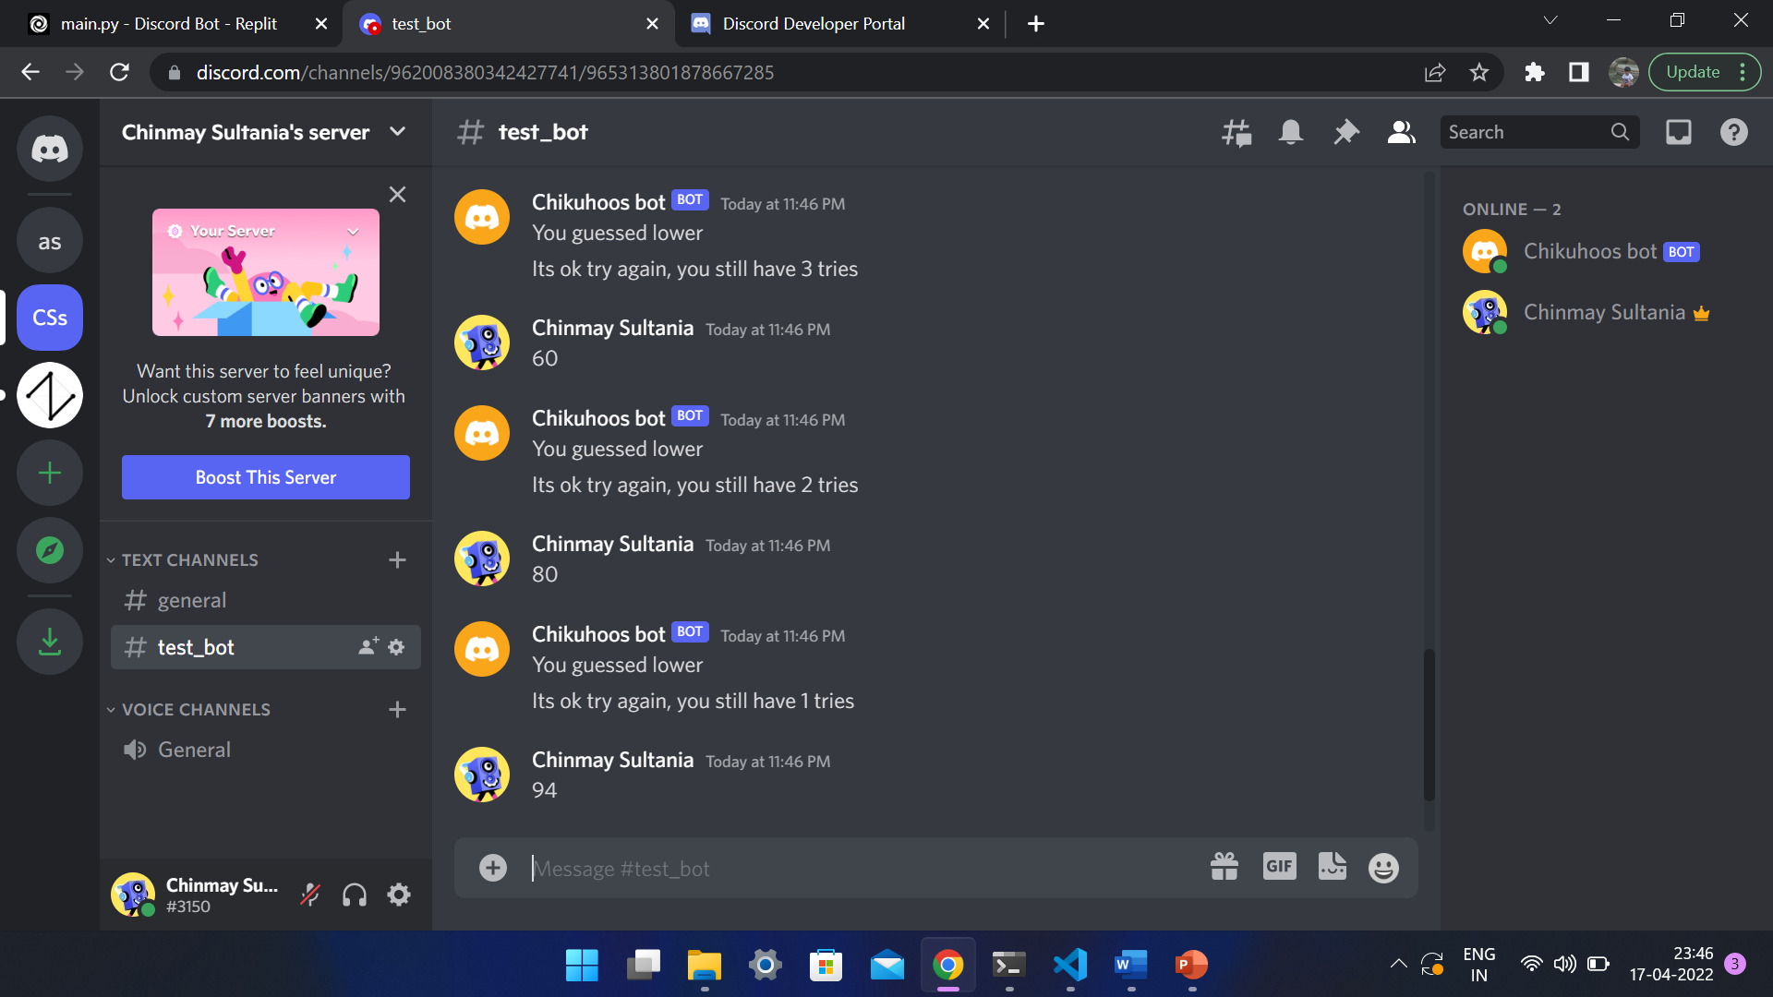

Slide 10
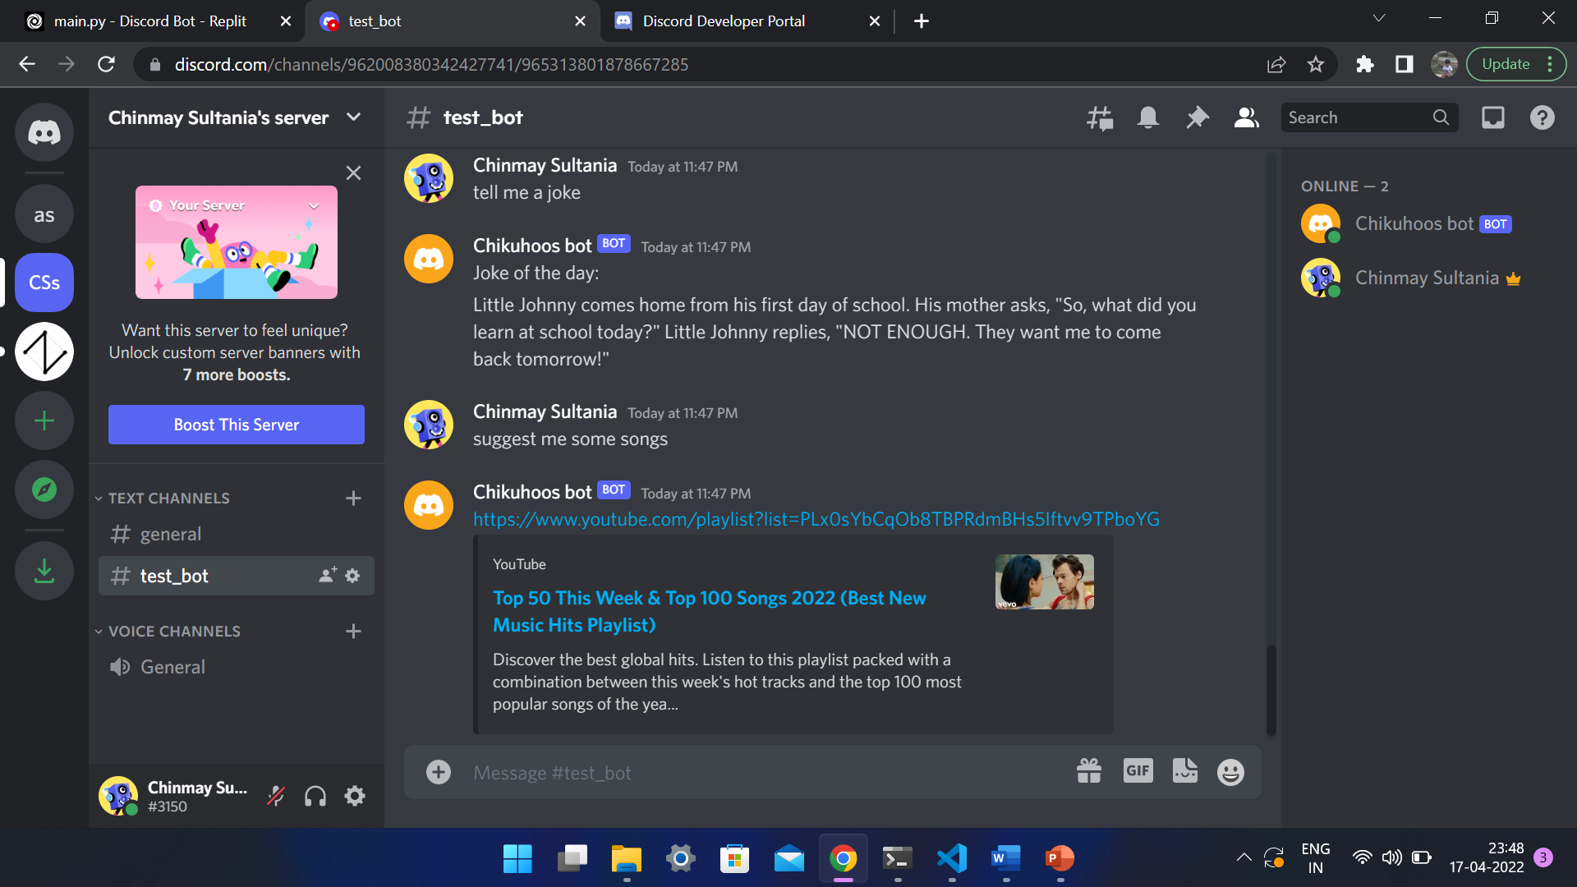

Slide 11


Slide 12
How to Use
Link to invite bot to server:
https://discord.com/api/oauth2/authorize?client_id=963049533233823814&permissions=532576430144&scope=bot

